Slide 1
REVOLUTION LIBRARY
KAVINA A,
KANISHQ RAJ G,
KISHOREKUMAR P,
NIRMALRAJA GOPALAN M

Slide 2
agenda
INTRODUCTION
PRIMARY GOALS
ADOPTION OF DIGITAL LIBRARIES
FEATURES
SUMMARY

Slide 3

introduction
The functioning of the libraries has shifted from traditional functioning to use moderthe of n ICT (Information Communication Technology) and Artificial Intelligence.
Many college library websites provide general and inadequate information on their webpage which makes them inaccessibility of or the user community since they are not updated regularly. The library website should be well-designed and well-structured that will provide the required, useful and adequate information for the academic user community

Slide 4
primary goals

Slide 5
PRIMARY GOALS
Providing access to information
Internal search engines
Online reference service
Stable links to other Internet sites.
Access to the online catalogue and other databases.
Basic information about the library( hours, staff, collections, etc,)
And timely updates.

Slide 6
ADOPTION OF DIGITAL LIBRARIES
It is high time for libraries in India to shift from the traditional model to the digital model.
This study provides highlights about the key areas in which researchers are doing research with respect to Digital Library and user experience to provide future scope for further research in this area.
The majority of studies, included in this paper, are related to the Adoption, Perception, Attitude, and Satisfaction of users toward Digital Library Services.
Whereas, Flow Experience and Equality aspect of Digital Library has also been studied by researchers.
The mobile library is emerging as a new concept and showing a high rate of acceptance among users where libraries provide content browsing through a mobile application

Slide 7
In the digital age, a public library can connect even the most remote community to networks of knowledge and information.

Slide 8
FEATURES
1. E-library is the easiest-to-use available online research tool.
2. Standards searching help the actors to integrate the technology into the curriculum, by increasing biology literacy. 47
3. Students can quickly and easily retrieve a manageable amount of quality content using the search-by-topic feature.
4. Public libraries need to offer an easy-to-use research solution to patrons.
5. Point-and-click functionality ensures all the users find the information they need.
6. The reference desk gives integrated access to a dictionary, encyclopedia, almanacs, and much more.
7. Visually impaired people are no longer disabled in searching and surfing information on the digital library.

Slide 9

INNOVATIVE FEATURES
1.No Physical Restrictions.
2. Multiple Access.
3. Easy to use.
4. Conservation and Preservation.
5.No Limitation of Space.
6. Scope of Improvement.
7. More than a Library.
8. Not Time-Bound
9.No Boundaries of Knowledge
10.No Language Bar

Slide 10
The Various Functions of E-Library:
• Access to a large amount of information – It provides a large amount of information to access the resources.
• User-friendly interface – It meets the demands of multiple users to access the system over the internet at the same time.
• Client-server architecture – Digital libraries provide support to their clients which can be accessed with common desktop configuration and software.
• Network accessibility – Online library system is a collection of disparate systems and resources connected through a network. 51
• Access to primary information sources – They provide a wide range of information to the users in digital form.
• Support multimedia content – This system supports the multimedia content.

Slide 11
EXISTING VS PROPOSED SYSTEM
1- Existing system does not have any facility for teachers login or student login whereas the proposed system will have a facility for student login as well as teacher login
2- Existing system does not have a facility for online reservation of books whereas the proposed system has a facility of online reservation of books
3- Existing system does not have any facility of an online notice board where the description of workshops happening in our college as well as nearby colleges is being provided.
4- Existing system does not have any facility to generate student reports as well as book issue reports whereas the proposed system provides librarians with a tool to generate reports.
5- Existing system does not have any facility for book requests and suggestions whereas in the proposed system after logging in to their accounts student can request books as well as provide suggestions to improve the library
6- The option of an online Notice board librarian will be able to provide a detailed description of workshops going in the college.

Slide 12
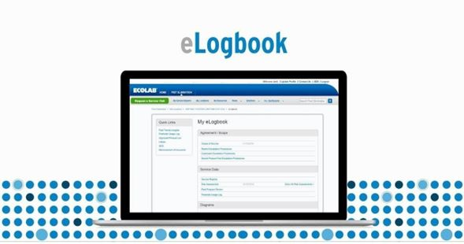
E-logbook
Statistical information about library
Complete details of the available books
Students Entry and Exit time.
Upcoming events in the library
List of e-journals.

Slide 13
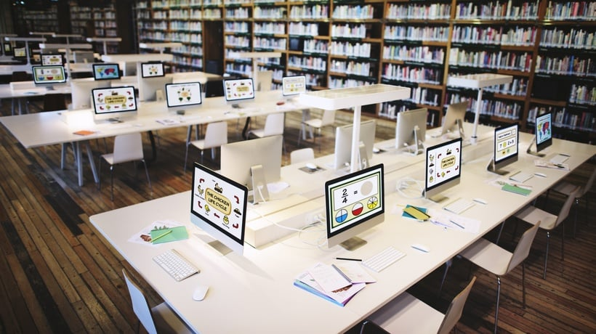
summary
This website provides a computerized version of library management system which will benefit the students as well as the staff of the library. It makes entire process online where student can search books, staff can generate reports and do book transactions. It also has a facility for student login where student can login and can see status of books issued as well request for book or give some suggestions. It has a facility of teacher’s login where teachers can add lectures notes and also give necessary suggestion to library and also add info about workshops or events happening in our college or nearby college in the online notice board. There is a future scope of this facility that many more features such as online lectures video tutorials can be added by teachers as well as online assignments submission facility, a feature of group chat where students can discuss various issues of engineering can be added to this project thus making it more interactive more user friendly and project which fulfills each users need in the best way possible.

Slide 14
thank you

